Slide 1

De-escalation Training
Stavros E. Delardas, LMSW, C-DBT, PMH-C, CLC
Manager, Maternal & Child Health Operations
sdelardas@chcrichmond.org

Slide 2

About the Facilitator
Stavros Efstratios Delardas is a Licensed Master Social Worker who has been with the Community Health Center of Richmond since 2014. As the Manager of Maternal & Child Health Operations, he oversees the Perinatal & Infant Community Health Collaborative (PICHC) & CHCR’s Behavioral Health department, while also serving as Chairman of the Workplace Safety & Infection Control Committee.
Stavros earned his Master of Social Work degree from Sacred Heart University and his Bachelor of Science in Human Services from Empire State College. He holds licensure as a Licensed Master Social Worker (LMSW) in New York & New Jersey. He is a trained Birth Doula and maintains certifications in Perinatal Mental Health & Lactation Counseling.

Slide 3


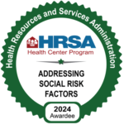


Our mission is to sustain a vibrant, healthy and strong community through affordable, culturally competent, quality primary health care. We aim to eliminate health disparities for underserved populations through accessibility. We empower people to take control of their physical and mental wellbeing through health education, prevention services and wellness programs.

Slide 4
Agenda
What is de-escalation?
Cultural Humility
Recognizing Escalation
Core De-Escalation Skills & Principles
Wrap-Up & Takeaways
Notes:
Does anyone know what de-escalation is?

Slide 5
Why is de-escalation important?
What is it?
a set of strategies used to reduce the intensity of conflict, agitation, or distress.
to create safety, restore calm, and prevent harm—without the need for physical intervention.
It is especially important in healthcare, where patients may be vulnerable, scared, or in crisis.
Why does it matter?
Protects safety of patients, staff, and visitors.
Preserves dignity of individuals experiencing stress, confusion, or agitation.
Supports therapeutic relationships by showing empathy and respect.
Meets compliance & best practice standards (CMS, OSHA, Joint Commission, etc.)

Slide 6
Before We Respond: Recognizing Bias, Privilege, and Power Dynamics
Self-awareness before implementing techniques
Notes:
Before diving into useful techniques, it is important to understand the many dynamics at play that we may not be considering. This understanding can allow us to be more aware and mindful of how we are approaching situations, perceiving others, and assumptions we may have.

Slide 7
Cultural Humility
Cultural humility is not about knowing all cultures. It's about knowing you have blind spots — and choosing to stay open, curious, and respectful when someone’s experience doesn’t match your own.
Notes:
Does anyone know what cultural humility is and how this differs from cultural awareness?
Cultural humility is the ability to recognize and respect that every patient comes from a unique background — including culture, language, race, gender, ability, and trauma history. It is not just about being “culturally competent,” but about remaining teachable and respectful. Cultural humility requires a lifelong commitment to self-evaluation and self-critique, especially regarding the internal biases we all carry, often unconsciously, based on our upbringing, culture, race, profession, and lived experiences.

Slide 8

Bias, Power, and the De-escalation Mindset
What to Recognize:
Recognize internal biases and power dynamics within the staff-patient dynamic.
Patients may feel helpless, especially in unfamiliar systems or settings.
Some patients may escalate not because of you, but because they’ve experienced systemic disrespect before (e.g., racism, sexism, poverty, medical gaslighting).
LGBTQ+, immigrant, and neurodivergent patients often report feeling disrespected or unsafe in clinical settings, which can heighten sensitivity to tone and body language.
Notes:
Internal bias
refers to automatic thoughts, stereotypes, or assumptions we may hold about others — even when we consciously believe in fairness and equity. Instead of assuming we’re bias-free, cultural humility asks us to continually examine our own position, and to acknowledge how power, privilege, and prejudice might affect our perceptions and responses — especially during conflict or escalation. Everyone has biases. Acknowledgement of our biases can allow us to be mindful of them when interacting with others. This is key in both being aware of factors contributing to escalation, as well as, what factors contribute positively to de-escalation practices.
Power Dynamics:
Refers to the way authority, influence, and control operate within relationships or interactions. In any setting, especially healthcare. there are natural differences in power based on roles, knowledge, access to resources, and decision-making authority. These dynamics aren’t inherently negative; in fact, some level of structure and authority is necessary for safety and care. However, when power is unbalanced or used without awareness, it can create tension, fear, or resistance, especially in situations where someone already feels vulnerable, such as a patient receiving care. Understanding power dynamics means recognizing how your position, words, tone, and actions can influence another person’s sense of control. When we are aware of these dynamics, we can communicate in ways that restore a sense of balance, reduce defensiveness, and nurture collaboration, which are important considerations in successful de-escalation.
Systemic Influence:
When we talk about de-escalation, it’s important to recognize that not every reaction is about this moment alone. Many individuals carry experiences shaped by broader systemic issues—such as racism, homophobia, sexism, ableism, or classism—that have influenced how safe or respected they feel in certain environments, including healthcare.
Someone who has experienced discrimination or bias in the past may approach healthcare staff with mistrust, defensiveness, or fear—not necessarily because of the current interaction, but because it echoes past harm. Even subtle cues (like tone, body language, or perceived dismissiveness) can trigger those feelings. As professionals, understanding these systemic layers allows us to respond with empathy rather than judgment. It reminds us to slow down, validate emotions, and focus on rebuilding trust—acknowledging that each person’s reaction is part of a larger story, not just a single encounter.

Slide 9

Cultural Humility in Practice
Avoid assumptions.
01
Ask instead of assume.
02
Be aware of power and identity.
03
Normalize Emotion
04
Notes:
Avoid assumptions about how a patient “should” behave — cultural expressions of distress vary.
Ask instead of assume: “Is there a way I can explain this better for you?” or “Would you prefer a different language or interpreter?”
Be aware of power and identity: For example, patients from marginalized communities may escalate faster if they feel ignored, judged, or dismissed based on past experience.
Normalize emotion without labeling behavior as “aggressive” based only on tone or volume.

Slide 10
Recognizing Escalation
Common Triggers
Early Warning Signs
Intentional & Unintentional Escalation

Slide 11
Common Triggers in Healthcare
Long wait times or delays.
Communication breakdowns or confusing information.
Billing and/or insurance issues.
Perceived rudeness, disrespect, or judgement.
Fear, pain, or anxiety
Perceived lack of control or lack of choice.
Behavioral health or substance use conditions.
Combination of multiple factors.
Notes:
Questions for the group:
What are some common triggers that escalate situations? Do you have any personal examples of times where you became upset, agitated, or angry?
What are some common triggers that you think a patient might experience? What experiences have you had when accessing your own healthcare that may have been frustrating? How did you handle it? How did the staff handle it?
Content:
Long wait times: Not being seen on time; Other being called ahead of them (perception); No clear communication about the wait time.
Communication Breakdowns: Conflicting instructions; medical jargon or unclear instructions/explanations; staff appearing rushed or dismissive; discussing patients in public spaces.
Billing Issues: Surprise costs; Insurance issues; frustration with insurance or payment processes.
Perceived Rudeness: Short responses; lack of eye contact; being asked to repeat themselves; being “corrected”; assumptions made about patients; tone and body language.
Fear, pain or anxiety: fear of diagnosis or treatment; physical discomfort; anxiety or other behavioral health concerns; fear of being ignored, forgotten, or judged due to previous experiences.
Loss of Control/Choice: Being told “what to do,” with no reason or easily understood instructions; no options or alternatives offered (or explanations why there may be only one option); Feeling “talked down to” or disregarded; receiving negative news regarding their health.
BH Concerns: Withdrawal symptoms; Hallucinations or delusions; Executive functioning issues (e.g., difficulty waiting); Feelings of being misunderstood.
It is important to recognize that we may never know why someone may be reacting the way that they are, or that we may disagree with their reasoning or reasons they are providing. Understanding that our perception and someone else’s perception may not always align is essential, as it can allow us to attempt to move toward a solutions-based approach, rather than a problems-focused or defensive one.

Slide 12

Early Warning Signs
Verbal Indicators
Non-Verbal Behavior
Facial Expressions
Emotional Indicators
Boundary Testing
Notes:
Early warning sides are a great way to begin to address situations before the escalate or become worse. We all show signs of how we are feeling, whether we notice or not. –Give a personal example-
Verbal Indicators: This may be one of the more obvious indicators – Changes in tone (more direct, curt, volume); passive or aggressive remarks; sarcasm.
Non-verbal behaviors: Fidgeting, restlessness, clenched fists, pacing, stiff posture, deep sighs, tapping hands or feet.
Facial Expressions: Eye rolling, narrowed eyes, grinding teeth, forced or insincere smile, flushed face, pursing of lips.
Emotional Indicators: Irritability, impatience; visible frustration, emotional verbal cues (“you’re not listening;” cursing, etc.)
Boundary Testing: Interrupting staff, questioning rules repeatedly, “pushing back” subtly or aggressively.

Slide 13
Unintentional Escalation
Notes:
There are times we may unintentionally escalate a situation, which commonly occurs when we are not mindful of how we may be delivering information, both through verbal and on-verbal cues.
Using a sharp, rushed, or impatient tone
“What’s the problem now?” or “You’re going to have to calm down,” even if you think you’re being neutral.
Sounding dismissive or minimizing
“It’s not that bad.”
“Other patients have it worse.”
“We already explained this.”
Overly clinical language with no translation
Rapid-fire medical jargon that makes the person feel stupid, excluded, or scared.
Talking about the patient as if they’re not in the room
“She’s non-compliant,” “He’s dramatic,” said to another staff member within earshot.
Correcting or arguing about “small” details
“It wasn’t three hours, it was two.”
“You didn’t call three times, I only see one call here.” This can feel invalidating when they’re trying to express distress.
. Body Language & Nonverbal Cues
Standing over the person (towering at the bedside, arms crossed)
Feels intimidating or like a power move even without intending it.
Lack of eye contact or turning your back while they’re talking
Can feel like, “You’re not worth my time.”
Heavy sighing, eye-rolling, checking the clock/door
Signals annoyance or wanting to escape, which can provoke anger or shame.
Moving too close or touching without clear consent
4. Control, Rules, and Boundaries (The Way They’re Communicated)
Quoting policy instead of acknowledging feelings first
“That’s the rule,” “We don’t do that here,” without any empathic lead-in can sound cold and authoritarian.
Sudden changes without preparation
New provider, new room, new plan, or long delay with no update = the person feels powerless and suspicious.
Using threats (even subtle ones)
“If you keep this up, I’ll have to call security,” said too early or too casually.
Documentation & “Side Conversations” That Patients Overhear
Saying “difficult,” “non-compliant,” or “attention-seeking” out loud while charting
If the patient hears/reads this later, it can destroy trust and escalate future encounters.
Vent sessions at the nurses’ station within earshot
“That guy in Room 4 is driving me nuts,” can travel quickly and fuel conflict.
Promising something and not circling back
“I’ll be right back,” “I’ll check on that,” and then hours pass = mistrust + frustration.
Inconsistent limits between staff
One staff says “yes” to something, the next says “absolutely not,” without explanation. Patients often escalate when the system feels unfair or arbitrary.

Slide 14

Core De-Escalation Skills & Principles
Notes:
Before diving into some of the principal of de-escalation, it is important to recognize that the most powerful tool in this process is not a technique, it is ourselves. How we carry ourselves in situations can make the difference of a situation escalating further, or de-escalating.
Non-Verbal Awareness
Why it matters: Body language often communicates more than words.
How to do it:
Keep your posture open, hands visible, and movements slow.
Make eye contact that is respectful but not staring.
Avoid crossing arms, pointing, or appearing rushed.
Avoid showing non-verbal cues of frustration.

Slide 15
Stay Calm & Controlled
Notes:
In a heated moment, you can’t control someone else’s behavior, but you can control yours and the energy you bring into the room. Calm isn’t passive; it’s power with purpose. Your tone, body language, and emotional state often set the tone for the interaction. When tension rises, your calm can be contagious. Staying composed communicates safety, confidence, and control, not dominance. Remember, in a crisis, the other person might not be able to think rationally, their brain is in fight, flight, or freeze mode. Our calm presence helps signal that they don’t need to stay in that heightened state. This doesn’t mean to approach these situations without any emotion, rather it is about approaching an interaction with calmness to assist in regulating how someone else may be feeling.
How to do it:
Breathe intentionally: Slow, steady breathing helps regulate your own body before addressing others. Practically, that means taking slow, deep breaths — even if it’s just one in the middle of the conversation. It is important to be mindful of taking a deep breath and sighing in frustration. This can make a difference in the other person’s perception of our own behavior, even if not intentional.
Lower your tone & volume: Speak slowly, clearly, and softly, it reduces the likelihood of someone feeling threatened, even if its only a perceived threat. Sometimes, silence is more powerful than any words we may use. Silence can be uncomfortable, but it often gives the other person space to breathe, think, and regain control.
Keep neutral posture: Body language matters too. Keep your hands visible and relaxed, don’t cross your arms, and maintain a safe distance. This shows you’re not a threat but you’re also not afraid.
Name your own cues: Recognize signs of stress (tight jaw, raised voice, racing thoughts) and reset in the moment. Do a 3-count. In emotionally heightened situations, we often lean more into our emotional mind, rather than our rational one. Doing a short 3-count make a big difference in how we respond. It allows us the time to make a choice, rather than reacting.
Lastly, staying calm doesn’t mean you are being passive. It means that you are grounded. That you are able to respond thoughtfully, respectfully, and rationally. As a reminder, you cannot control someone else’s behavior, but you can control yours. This can often be the difference between an escalating situation and a manageable one.

Slide 16
Show Respect & Empathy
Notes:
Validate feelings without judgment. When tension is high, people often feel unheard, dismissed, or disrespected and that’s where empathy and respect make the biggest impact. Showing empathy doesn’t mean you agree with the person’s behavior; it means you recognize their emotions in that moment.
How to do it:
Treat every person with dignity, regardless of behavior: Respect starts with small things, using someone’s name, keeping your tone polite, avoiding sarcasm, and giving them personal space. Even when someone is yelling or being unreasonable, how we speak to them can completely shift the energy of the interaction.
Listen to understand, not to respond: Empathy is about understanding why someone might be reacting the way they are. Maybe they’re scared, frustrated, or feel powerless. When we take a step back and look at the emotion driving the behavior, we can respond more effectively
Acknowledge feelings before addressing actions: A good rule of thumb is to acknowledge feelings before addressing behavior. For example, instead of saying, ‘You need to calm down,’ you might say, ‘I can see this is really upsetting, let’s figure out how we can make this better.’ That statement recognizes their emotion and offers collaboration rather than control.
Use validating language: When we use validating language, we’re acknowledging how someone feels before we try to correct or calm them. It’s a simple way of saying, ‘I see you, and what you’re feeling makes sense.’ That recognition alone can start lowering defensiveness.” Validation doesn’t mean agreeing or approving, it just means understanding. For example, instead of saying ‘You’re overreacting,’ we can say ‘I can see this is really upsetting for you.’ That shift changes the entire tone of the conversation.” When people feel understood, they stop needing to prove their emotions are real. That’s when they start to calm down and are more open to working with you
Respect personal space, culture, and autonomy: It’s also critical to remember that every person we interact with comes from their own background and life experiences, including experiences with bias, discrimination, or trauma. Being mindful of those histories shows cultural humility and helps prevent re-traumatization.

Slide 17
Use Simple & Clear Communication
Notes:
When someone is escalated or under stress, their ability to process information goes way down. Even people who are usually calm and articulate can struggle to take in complex details when emotions are high. That’s why clarity becomes a de-escalation tool.
How to do it:
Use short, simple sentences: Using short, simple sentences helps people actually hear you. Instead of giving long explanations or multiple steps at once, break things down. For example, instead of saying, ‘I need you to sit down so we can take your vitals and get your medication ready,’ you might say, ‘Let’s start by sitting down together.’ One direction at a time.
Avoid medical jargon when possible: Avoiding medical jargon is also key. Words that make sense to us — like ‘triage,’ ‘compliance,’ or ‘vitals’ might sound confusing or even intimidating to someone who’s upset. Plain language helps build trust and makes your message more accessible..
Give one instruction at a time.
When you keep communication simple and calm, it reduces overwhelm, prevents misunderstanding, and gives the person a sense of control. That’s exactly what we’re aiming for in de-escalation.

Slide 18
Maintain a Safe Space
Notes:
In any tense interaction, physical space communicates just as much as words. When someone feels cornered, blocked in, or physically overpowered, their brain shifts into a survival mode, activating our fight, flight, or freeze responses. Our goal is to reduce that sense of threat by maintaining a safe, open space.
How to do it:
Respect personal space: As a general rule, keep about two arm’s lengths of distance whenever possible. This gives both you and the other person room to move and breathe, and it communicates that you’re not trying to control or contain them.
Keep exits visible and accessible: Make sure exits are visible and accessible, not because you expect danger, but because people instinctively feel safer when they know they have a way out. If someone feels trapped, even unintentionally, their anxiety will spike and they’re more likely to escalate
Avoid standing or cornering: Avoid standing directly over someone who’s sitting or crouching. That posture can feel intimidating or dominant. If appropriate, lower yourself slightly so you’re at eye level, it shows respect and reduces the power imbalance
The key idea is that safety is mutual. When the other person feels physically safe, you are actually safer too, because it lowers the chance of panic or aggression. Space isn’t just about comfort, it’s about maintaining control through maintaining calm and showing respect

Slide 19
Offer Choices, if Possible
Notes:
When someone is agitated, one of the main things they’ve often lost is a sense of control. They may feel powerless, unheard, or like decisions are being made to them instead of with them. Offering choices, even small ones, helps restore their sense of autonomy.
How to do it:
Frame requests as options: It doesn’t mean letting the person run the situation. It means reframing how we give direction. Instead of saying, ‘You need to sit down,’ you might say, ‘Would you like to sit here or over by the window?’ The task stays the same, but the tone shifts from command to collaboration.
Allow the person to say ‘no’ when it is safe to do so: When we give people safe opportunities to say ‘no,’ we actually reduce their need to resist. It gives them a sense that their voice matters. And when people feel they have some control, their anxiety and defensiveness drop
Reinforce autonomy, while keeping clear boundaries: You can also use this technique to reinforce boundaries. For example, ‘We can’t continue the conversation while voices are raised, but we can step outside or take a short break, which would you prefer?’ That keeps the limit clear while still giving choice and dignity.
Offering choices communicates partnership. It says, ‘I respect your ability to decide,’ which builds trust and trust is what keeps de-escalation safe and effective.

Slide 20
Non-Verbal Awareness
Notes:
How we communicate is often more important than what we say. Our body language, tone, and facial expressions send powerful messages, sometimes louder than our words. People in distress are hyper-aware of non-verbal cues, so the way we carry ourselves can either calm or escalate the situation. Intention is only part of communication, how it is received is just as important as our intention.
How to do it:
Open Posture: Keep your posture open and relaxed, with your hands visible. Hidden hands, crossed arms, or a defensive stance can make someone feel unsafe or like you’re closing off communication. Slow, deliberate movements show calmness, while quick or abrupt gestures can be misinterpreted as aggression, appearing rushed, or impatience.
Make eye contact: Eye contact is important, but balance matters. Too little can seem dismissive, but too much can feel intimidating or confrontational. Aim for brief, respectful eye contact that communicates attention, not challenge
Avoid showing non-verbal cues: Try to be aware of your facial expressions and tone. Even small signs of frustration, like sighing, eye-rolling, or checking your watch, can signal impatience or disrespect. The goal is to project calm, focus, and genuine presence.

Slide 21
Safety & Boundaries
Disengagement
Internal Protocols
Notes:
Safety is the foundation of de-escalation, for both staff and the individual in distress. Clear boundaries protect everyone involved and maintain professionalism. De-escalation isn’t about forcing calm; it’s about guiding it, but only when it’s safe to do so. One of the most important skills is knowing when to engage, and when to disengage. Our goal is to reduce risk, not to win an argument or ‘fix’ the situation at all costs. We should not be ‘in it to win it,’ when approaching de-escalation. We should be utilizing a solutions-focused approach and to bring calm.
How to do it:
Know when to disengage if the situation becomes unsafe: If someone’s behavior becomes threatening, for example, yelling aggressively, making physical threats, or closing distance in a way that feels unsafe, it’s appropriate to step back and disengage. Calmly explain that you’ll return once everyone can communicate safely. This keeps the interaction respectful while reinforcing boundaries. Boundaries protect both parties. They communicate that we’re willing to help, but only within limits that keep everyone safe. Saying something like, ‘I want to continue this conversation, but I can’t do that while voices are raised,’ maintains respect while setting a clear expectation.
Follow established safety protocols (team response, code words): Always follow your organization’s safety protocols, whether that means activating an alert system, calling a supervisor, or using a team approach. Safety plans exist for a reason and using them early prevents escalation from becoming a crisis.
Maintain awareness of escape routes and environmental hazards: Environmental awareness also matters: know where your exits are, keep a clear path between yourself and the door, and avoid getting trapped in corners or behind desks. Your physical positioning should allow a calm exit if needed.
Use team communication to coordinate safely: Finally, communicate with your team. If you sense tension building, use code phrases to alert others. De-escalation works best as a team process, not a solo effort.
Set firm but respectful limits when behavior crosses safe boundaries: Boundaries don’t shut people down, they make the space safe enough for true connection to happen. You can’t offer empathy or validation if you don’t feel safe. So protecting your safety is actually part of providing compassionate care.
Involve law enforcement only as a last resort: In rare cases, even with the best de-escalation efforts, a situation can reach a point where safety can’t be maintained. That’s when calling for additional help including law enforcement, may become necessary. But this should always be a last resort. If that call needs to be made, it’s important to remain calm, use clear communication, and debrief afterward with your team. Reflect on what led to that point and consider whether earlier interventions or environmental changes could reduce the likelihood of reaching that stage again. Most importantly, we continue to treat the individual with dignity — even during a crisis response. Safety and empathy can coexist. The person should never feel like they’ve been abandoned or criminalized for struggling

Slide 22
Wrap-Up & Takeaways
Notes:
I want to bring everything back to the core message of de-escalation, this isn’t about control; it’s about making connections. The way we show up in these moments often determines how safe and supported someone feels.
When you stay calm and respectful, you help stabilize the situation.
When you validate and listen, you help people feel seen.
When you set clear boundaries and maintain safety, you protect not only yourself, but everyone involved.
Remember that every person we encounter is carrying their own story, trauma, stress, fear, or frustration. De-escalation isn’t about fixing someone; it’s about responding with professionalism, empathy, and calm.
De-escalation takes practice. It’s okay if you don’t always get it perfect, what matters is your awareness and your effort to keep learning and improving. In closing, keep these tools in mind: calm presence, empathy, validation, clear communication, safe space, and strong boundaries. Ultimately, successful de-escalation isn’t just about avoiding conflict. It’s about preserving dignity, theirs and yours, and helping every interaction end a little safer and a little more human.

Slide 23
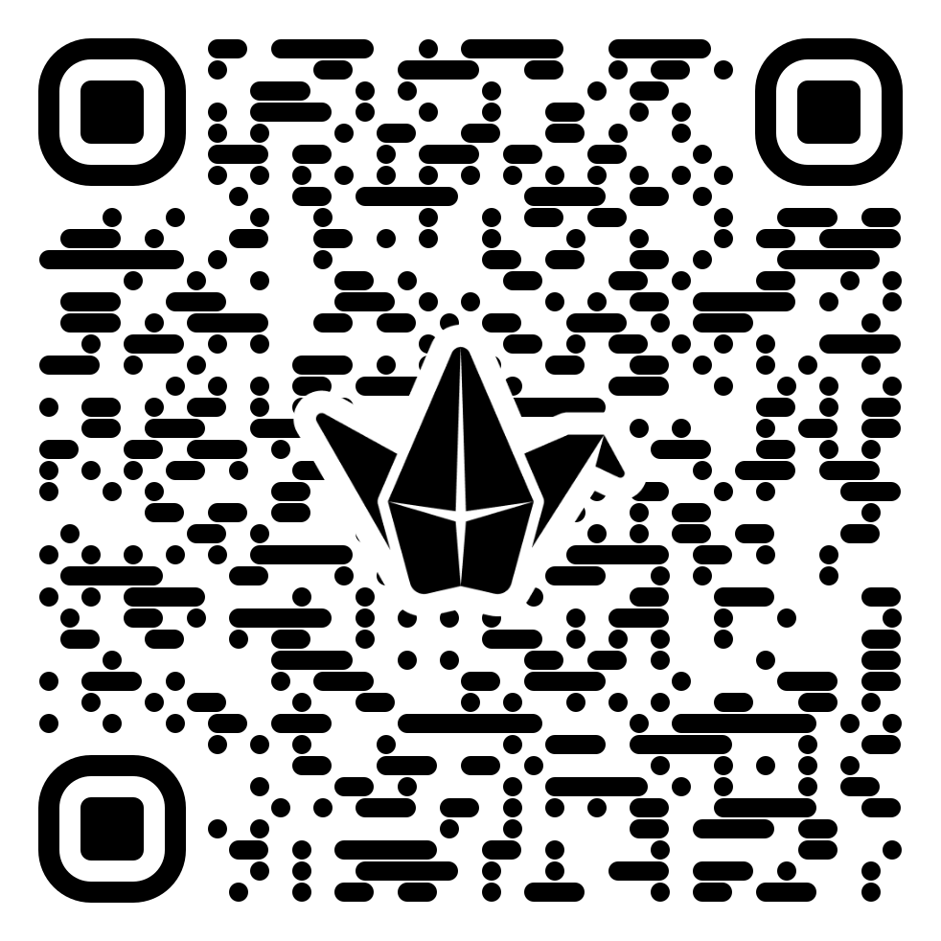
De-escalation Resource Hub

Slide 24
Thank you
Stavros E. Delardas, LMSW, PMH-C, CLC
(718) 876 – 1732 x7519
sdelardas@chcrichmond.org

Slide 25
References
Goodman, H., Papastavrou Brooks, C., Price, O., & Barley, E. A. (2020). Barriers and facilitators to the effective de‑escalation of conflict behaviours in forensic high‑secure settings: A qualitative study. International Journal of Mental Health Systems, 14, Article 59. https://doi.org/10.1186/s13033‑020‑00392‑5
Institute for Healthcare Improvement. (2019). Improving Health Equity: Build Infrastructure to Support Health Equity [Guide]. Institute for Healthcare Improvement. https://www.ihi.org/resources/Pages/Publications/Improving-Health-Equity-Build-Infrastructure-Guide.aspx
Price, O., Papastavrou Brooks, C., Johnston, I., et al. (2024). Development and evaluation of a de-escalation training intervention in adult acute and forensic units: The EDITION systematic review and feasibility trial. Health Technology Assessment, No. 28.03. National Institute for Health and Care Research. NCBI
Substance Abuse and Mental Health Services Administration. (2014). Trauma‑Informed Care in Behavioral Health Services: Treatment Improvement Protocol (TIP) Series 57 (HHS Publication No. SMA 13‑4801). Rockville, MD: U.S. Department of Health and Human Services
Tervalon, M., & Murray-García, J. (1998). Cultural humility versus cultural competence: A critical distinction in defining physician training outcomes in multicultural education. Journal of Health Care for the Poor and Underserved, 9(2), 117‑125.
Trauma Interventions Research Center. (2020, May 15). Calming & de-escalation strategies [Video]. YouTube. https://youtu.be/R2PSExM-NhU?si=iwEg0jrunNycDTeT
Yeager, K. A., & Bauer‑Wu, S. (2013). Cultural humility: Essential foundation for clinical researchers. Applied Nursing Research, 26(4), 251‑256. [https://doi.org/10.1016/j.apnr.2013.06.008](https://doi.org/10.1016/j.apnr.2013.06.008)

